Slide 1


Iconic Saga
Vidsummit learnings
2024
VidSummit takeaways
Kent Heckel

Slide 2

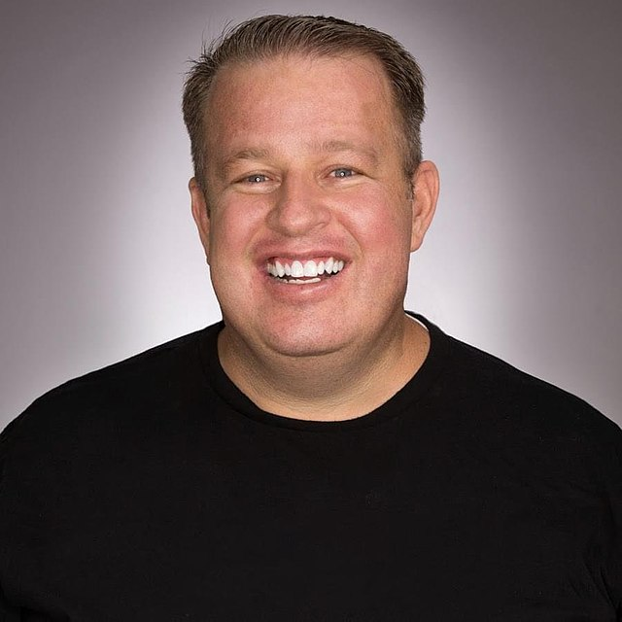
Iconic Saga
Vidsummit learnigns
2024
Darrel Eves - talk 1
Founder of Vidsummit, MrBeasts main consultant, creator of “The Chosen”, the highest crowd-funded TV series or film project of all time. Responsible for 74 billion youtube views
Darrell's main point was audience recognition. We cannot properly grow how we want until we fully understand our audience. He presented the idea of an “Avatar”

Slide 3

Iconic Saga
Vidsummit learnings
2024
Who are they?
What do they watch?
Your audience's identity is shaped by their demographics, interests, and values. Understanding who they are helps tailor content to resonate with their personal experiences and expectations.
Knowing the types of content they consume gives insight into their preferences, whether it's educational videos, entertainment, or niche topics. This helps align your messaging with what already captures their attention.
What else do they do?
Beyond watching content, your audience engages in activities like social media interactions, participating in online communities, and browsing relevant websites. These behaviors offer additional touchpoints to connect and engage with them.
Avatar

Slide 4
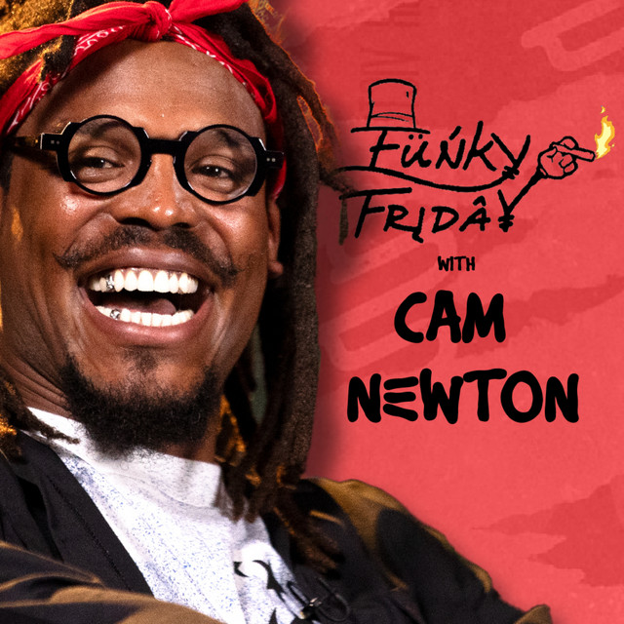
Iconic Saga
Vidsummit learnings
2024
Who are they?
What do they watch?
Our audience is predominantly males aged 25-44, based mostly in the U.S., particularly in states like Texas, Georgia, and Florida, with interests in sports, pop culture, and controversial discussions.
They watch long-form interviews, debates, and discussions featuring high-profile or controversial figures, with a focus on sports personalities, pop culture drama, and societal issues.
What else do they do?
Online, they engage with content on social media platforms like YouTube, follow trending news, participate in sports forums, and watch other commentary-driven channels related to pop culture and real-life stories.
Avatar

Slide 5
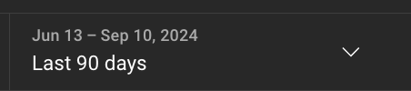
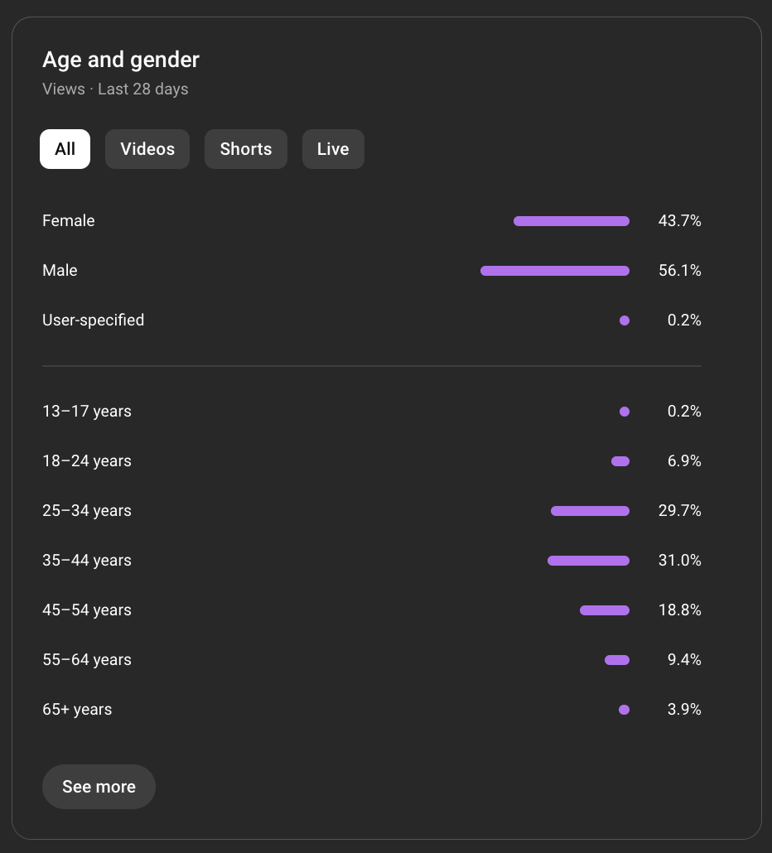
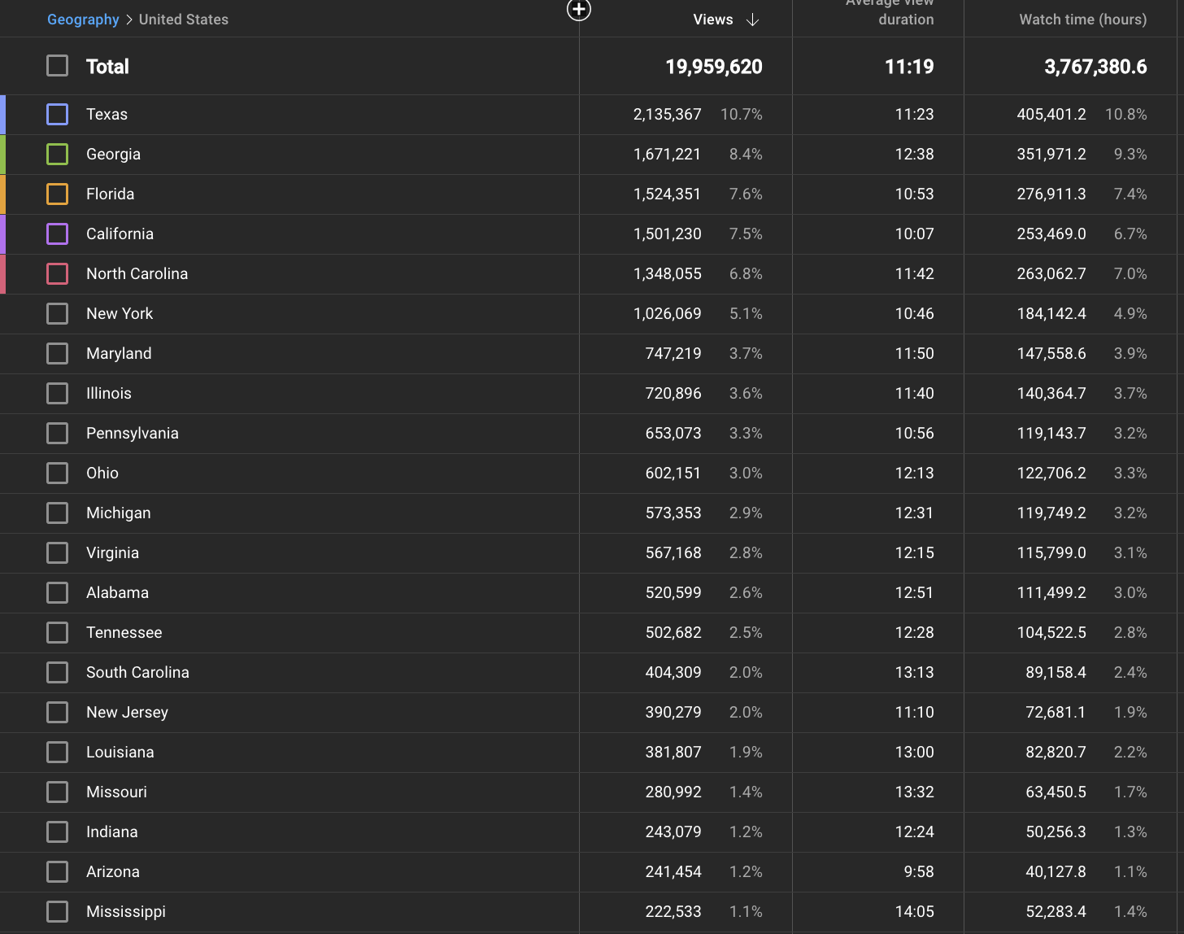
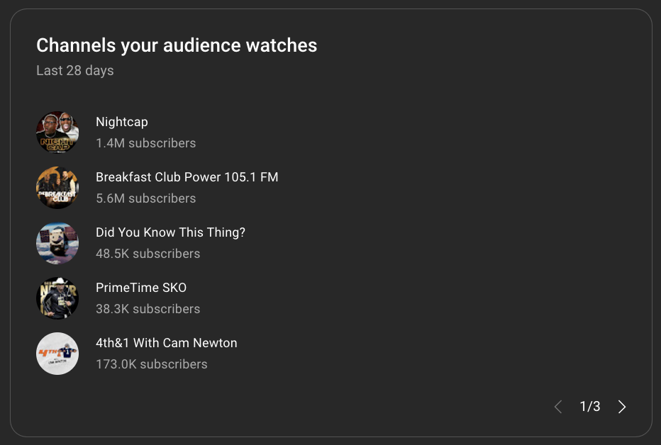
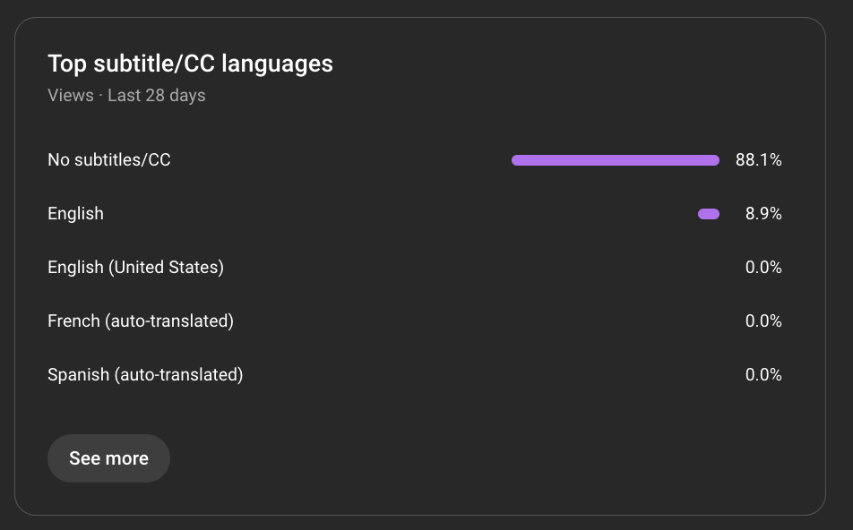
Iconic Saga
Vidsummit learnings
2024
Where is this data coming from?

Slide 6
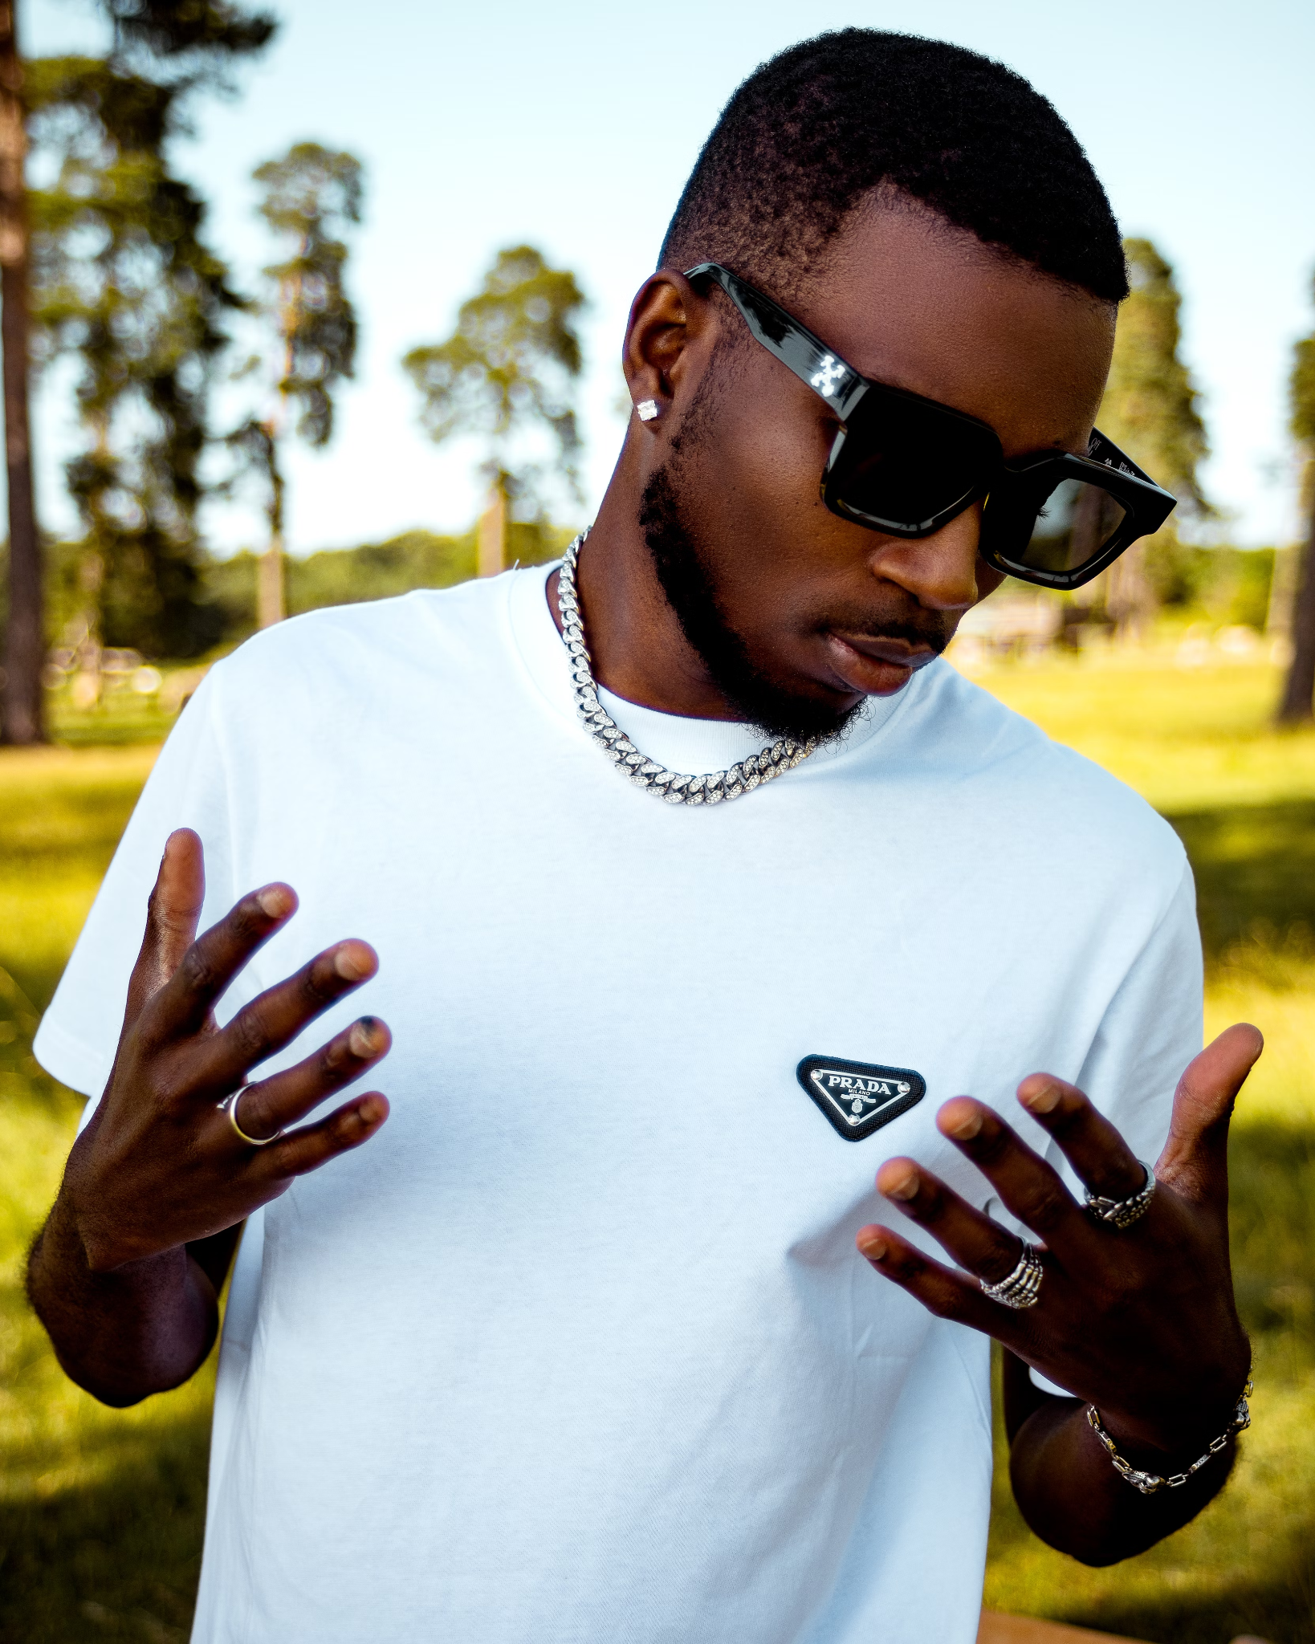
Iconic Saga
Vidsummit learnigns
2024
Mike Johnson - link
Name: Mike Johnson
Age: 32 years old
Location: Dallas, Texas
Occupation: Mid-level sales manager in tech, possibly runs a sports blog or coaches on the side.
Personality:
Driven, competitive, and loves engaging in debates about sports and pop culture.
Social and outgoing, he spends weekends with friends watching games, going to bars, or playing pickup basketball.
Weekday Routine:
Works a 9-to-5 in sales, catches sports news on breaks, and watches podcasts or games in the evening.
Weekend Routine:
Saturday: Watches sports with friends at bars.
Sunday: Dedicated to NFL football, watching games for several hours.

Slide 7

Iconic Saga
visummit learndngs
2024
Favorite Channels
What He Watches
Funky Friday (your podcast), The Breakfast Club, Gils Arena, I AM ATHLETE, Deion Sanders @ Colorado & Family, Joe Budden Podcast, Well Off Media, RealLyfe Productions.
Mike follows a mix of sports commentary, celebrity interviews, and cultural discussions, always looking for authentic, bold conversations.
Long-form interviews and debates featuring high-profile or controversial figures.
Drawn to bold discussions on pop culture, sports, and social issues that give him fuel for discussions.
Prefers candid, unfiltered conversations from guests who aren't afraid to speak their minds.
Social Media Usage
Viewing Patterns
YouTube: Mike spends 1-2 hours per day, primarily watching podcasts and highlight reels.
Twitter: He’s active for 30-45 minutes daily, using it to live-tweet during sports events and follow trending topics.
Instagram: 45-60 minutes daily, mostly watching sports highlights and memes on pages like House of Highlights.
Mobile: Primarily consumes short-form content (1-5 minutes) during breaks and downtime.
TV: Engages with longer content (1+ hours) on the weekends or in the evenings when he has more time.
Prefers to watch detailed sports breakdowns or in-depth interviews on his TV at home.

Slide 8
Iconic Saga
visummit learndngs
2024
Mobile-First:
TV Engagement:
Optimize content for short, digestible clips (1-5 minutes) for his mobile consumption.
Mike watches longer-form content on TV on weekends or evenings, so continue producing hour-plus episodes for deeper engagement.
Bold, Trending Topics:
Lifestyle:
Mike is drawn to controversial debates and high-profile guests. Focus on guests and topics that generate strong reactions.
Mike’s social life revolves around sports, and he’s highly engaged in fantasy football and sports betting platforms, which could be additional content touchpoints.

Slide 9
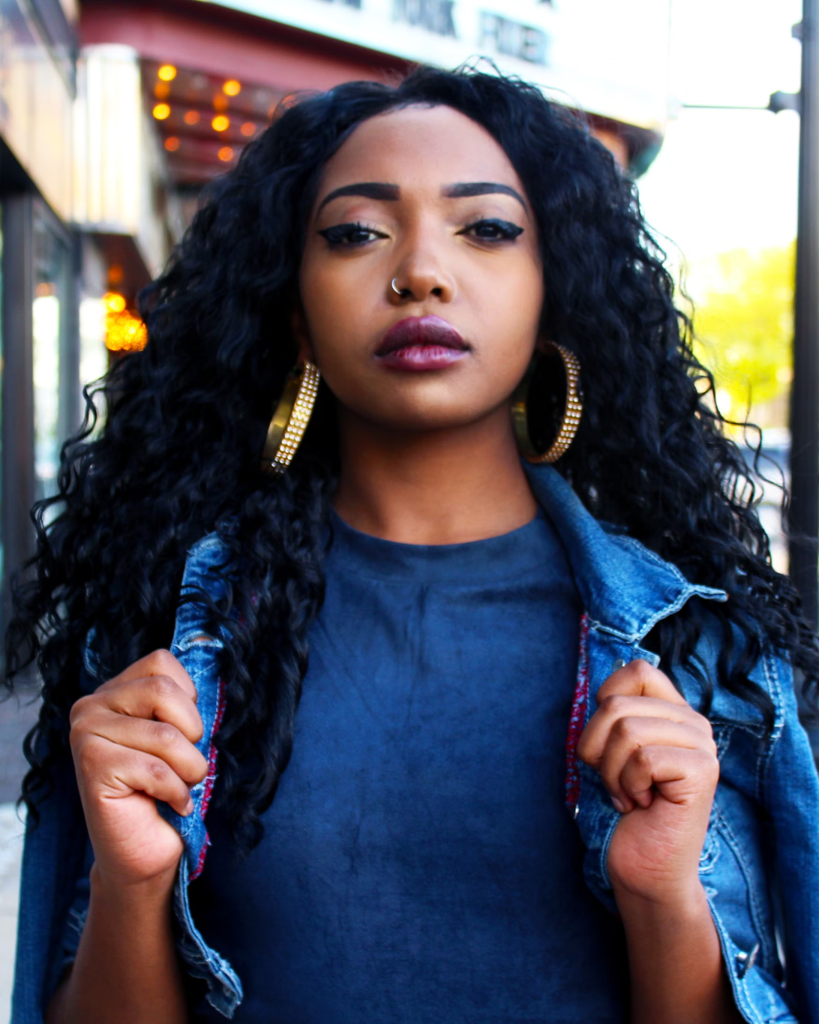
Iconic Saga
Vidsummit learnigns
2024
Maya Turner - link
Age: 29 years old
Location: Atlanta, Georgia
Occupation: Marketing Coordinator, ambitious and career-driven
Personality:
Social, loves spending weekends with friends at brunch or events
Values self-care Sundays, often spent relaxing with podcasts or YouTube
Deeply connected to pop culture, social issues, and personal growth
Hobbies: Engages in conversations about celebrity culture, trending topics, and enjoys long-form content during downtime.

Slide 10
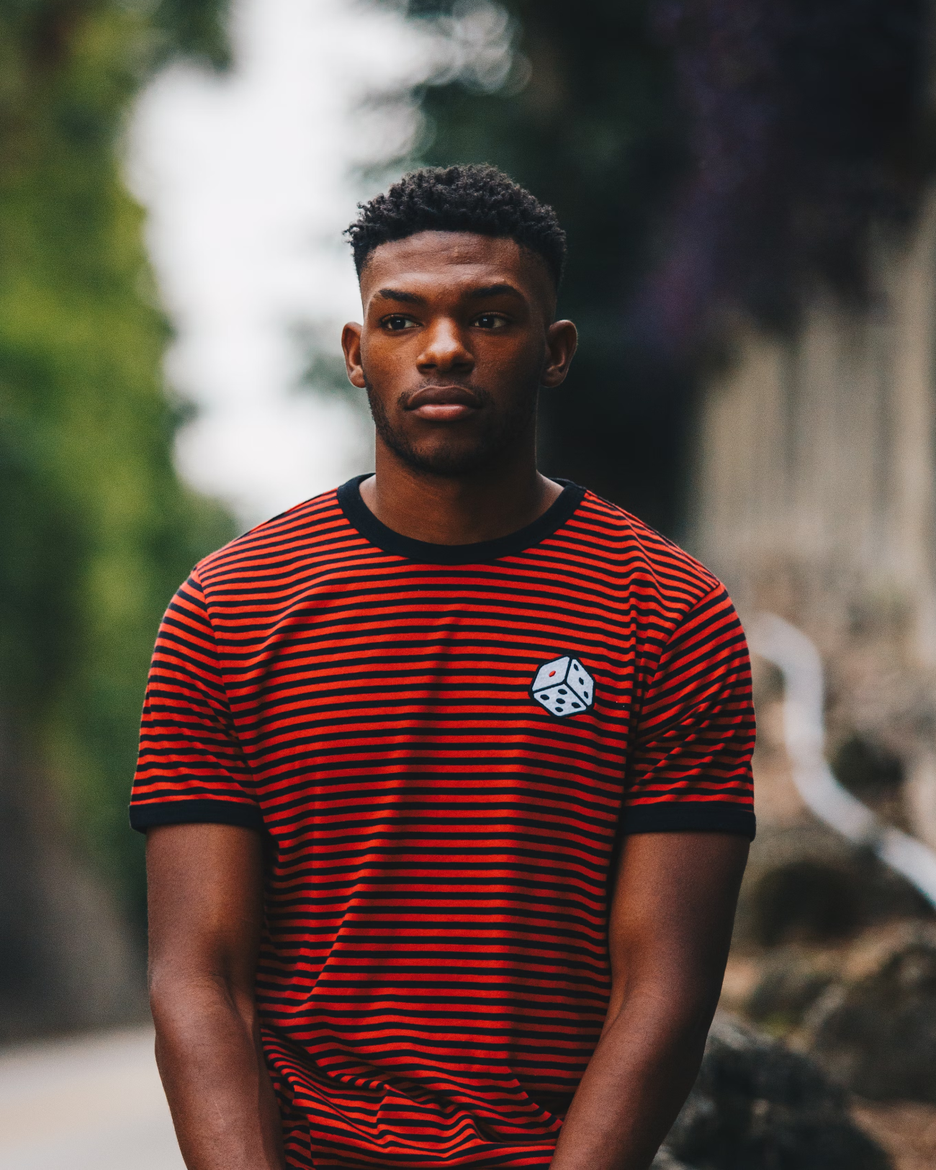
Iconic Saga
Vidsummit learnigns
2024
Jason Matthews - link
Age: 29 years old
Location: Houston, Texas
Occupation: IT Support Specialist
Personality:
Passionate sports enthusiast, especially NFL & NBA
Tech-savvy, enjoys upgrading his home setup and staying on top of tech trends
Curious learner, interested in trivia and unique facts related to sports and tech
Engages in friendly debates and enjoys bold opinions, particularly about sports
Hobbies:
Watches sports talk shows and podcasts, prefers unfiltered athlete-driven conversations
Active on Twitter during live sports events, engaging in discussions and sharing reactions
Spends his downtime on YouTube, watching sports highlights and interviews

Slide 11

Iconic Saga
visumbit lsagaseg
2024
Embrace what's working (FF)
Ask our avatar what they think
Our channel thrives on bold, controversial discussions featuring high-profile guests like Charleston White and Shannon Sharpe. Viewers love authentic, unfiltered conversations, especially around sports and pop culture. Long-form interviews have performed well, keep the videos 2+ hours. To build on this, we should continue focusing on candid debates and personal stories.
Before launching new content, we should think about what Mike Johnson and Maya Turner would want. Would Maya connect with a discussion on self-growth, or would Mike enjoy a heated debate on the latest sports drama? By tailoring our topics and guests to match their interests, we can better ensure the content will perform and resonate with our audience.

Slide 12

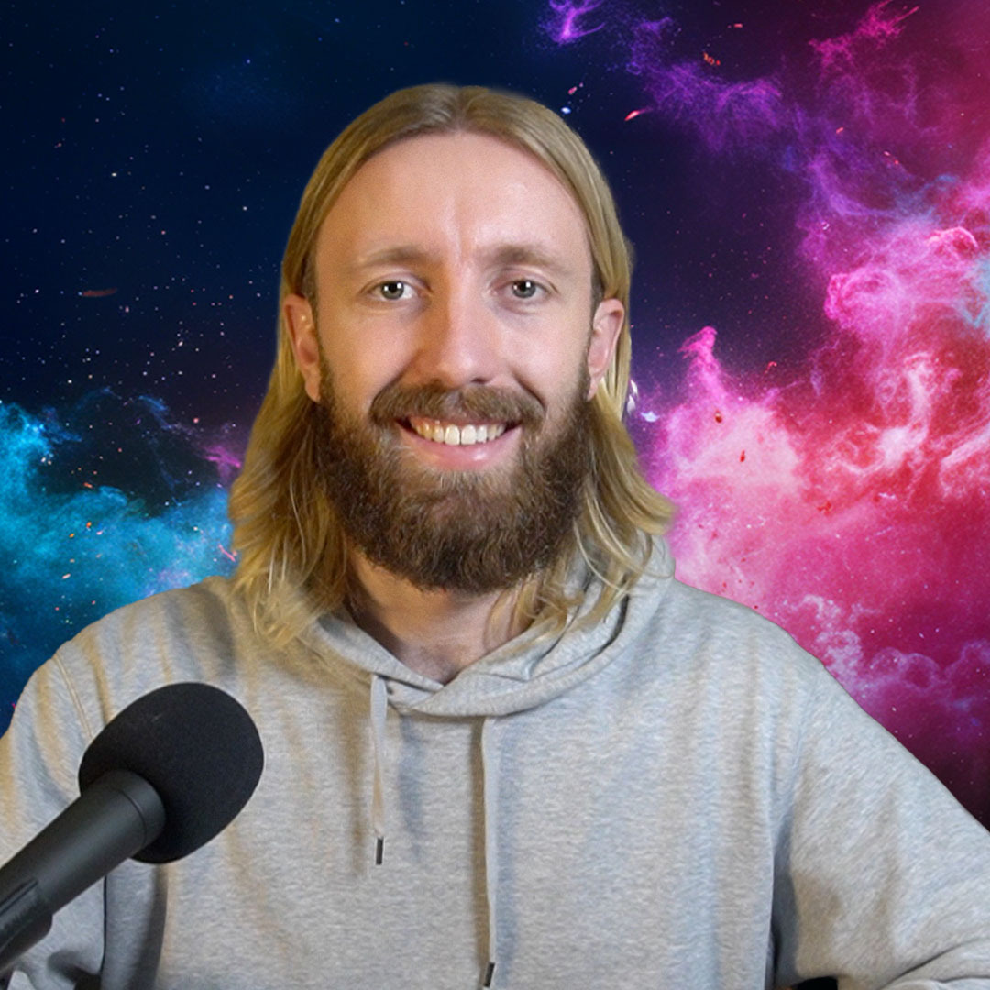
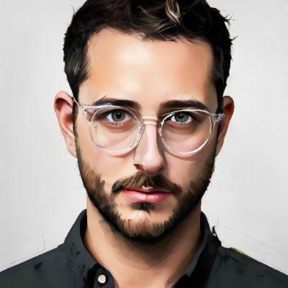
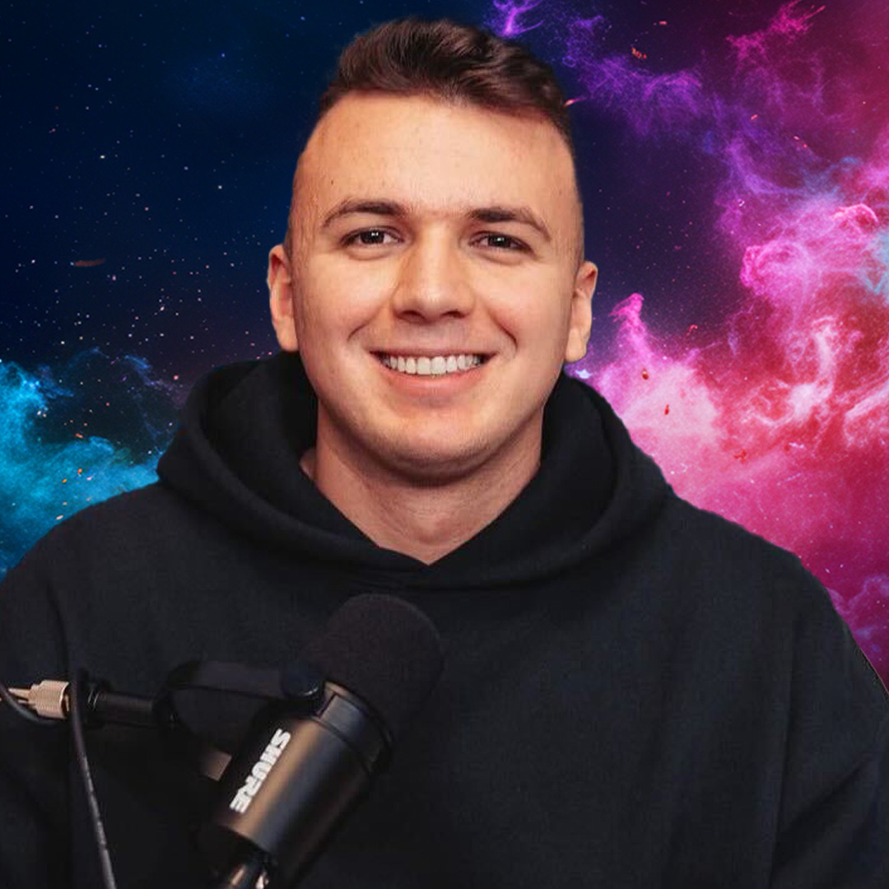
Iconic Saga
is anyone reading this?
2024
Thumbnails

Slide 13

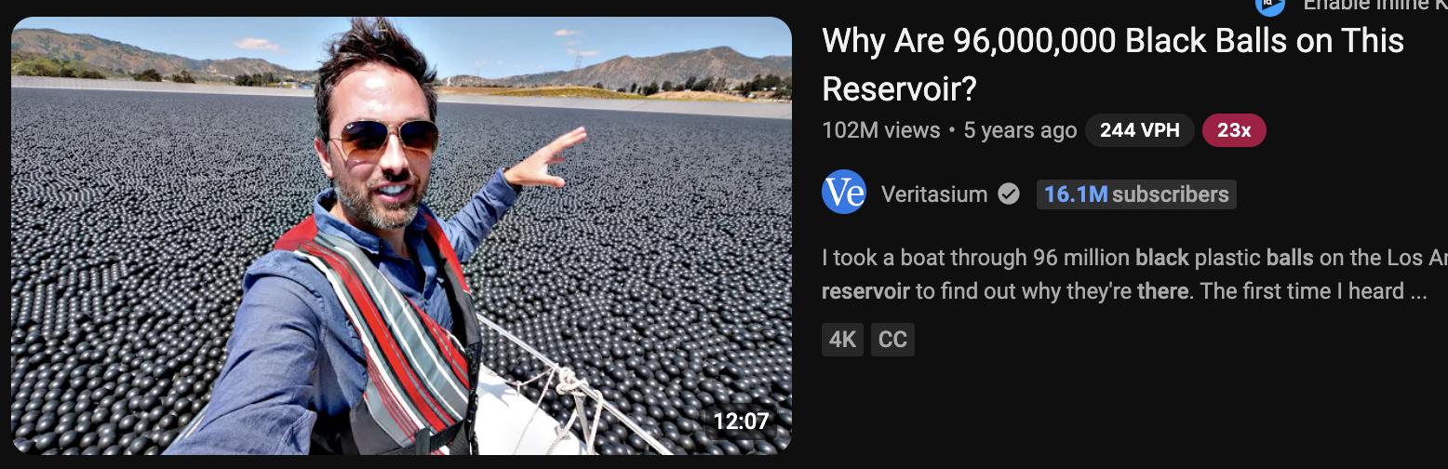
Iconic Saga
vid summit lernings
2024
The thumbnail information gap
The "information gap" technique in YouTube thumbnails is about sparking curiosity by posing a question or showcasing something intriguing without providing all the answers. The title and image raise immediate questions, creating a need for viewers to find out more. This gap between what the viewer knows and what they want to know encourages clicks.
For our podcast interview thumbnails, we can adopt this strategy by using strong visuals and titles that raise questions
Thumbnail Strategy
Curiosity
Craft thumbnails that pose a provocative question or present an unusual image to capture attention. This gap in information makes the content irresistible.
Invite curiosity and encourage viewers to explore the interview for answers.

Slide 14
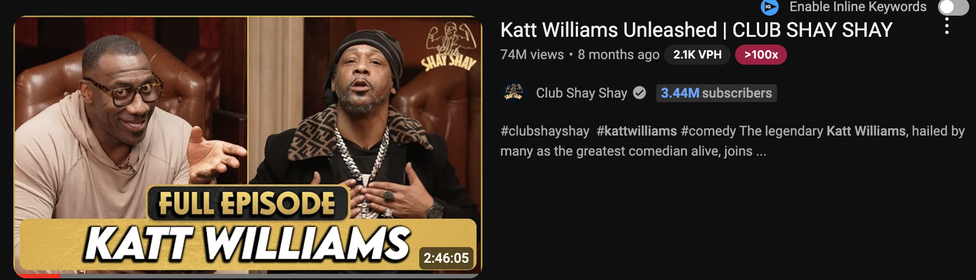
Iconic Saga
visummit learndngs
2024
What’s the biggest a video in our niche could go? (Addressable market)
Shorts to hero conversion
Vertical CTA in first 20 seconds
our average view duration on shorts is 79%
Come up with clever NON INTRUSIVE way to point to hero
vertical content is like being on facetime with our viewers, how can we improve that experience?
Same tricks new audience
Returning viewers
A magician shows the same tricks night after night, but to a new audience
What has worked in past that we could re package?
Cam wants to be new Arsenio Hall, what were his biggest hits? How could we repackage?
what of our content doesn't just GROW our channel, but brings viewers BACK
Top video returning viewers is… DR.BRYANT
She BROUGHT BACK 555,602 views to other content

Slide 15

Iconic Saga
visummit learndngs
2024
A/B test format
2
3
1
2
2b
2a
2a
2a²
2a³

Slide 16

Iconic Saga
Vidsummit learnigns
2024
Thumbnail checklist
Face & Emotion
Eye Catching colors
Simplicity
No text (podcast exclusion)
Contrast
No Empty Space
Wow factor
Conflict
Question

Slide 17
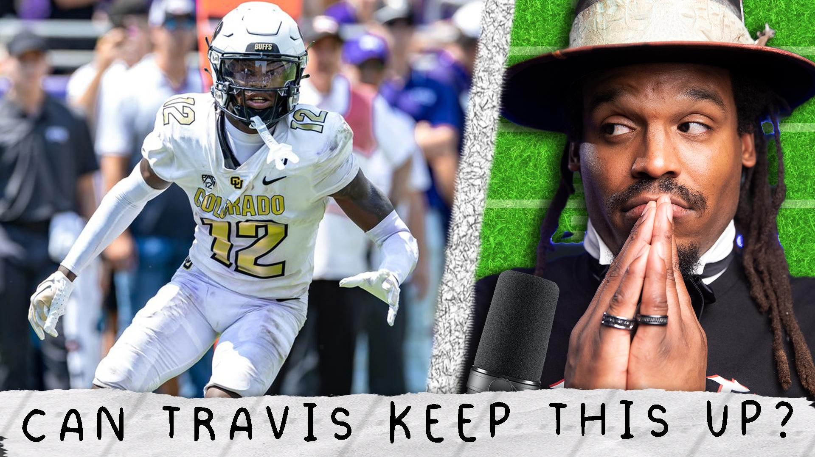
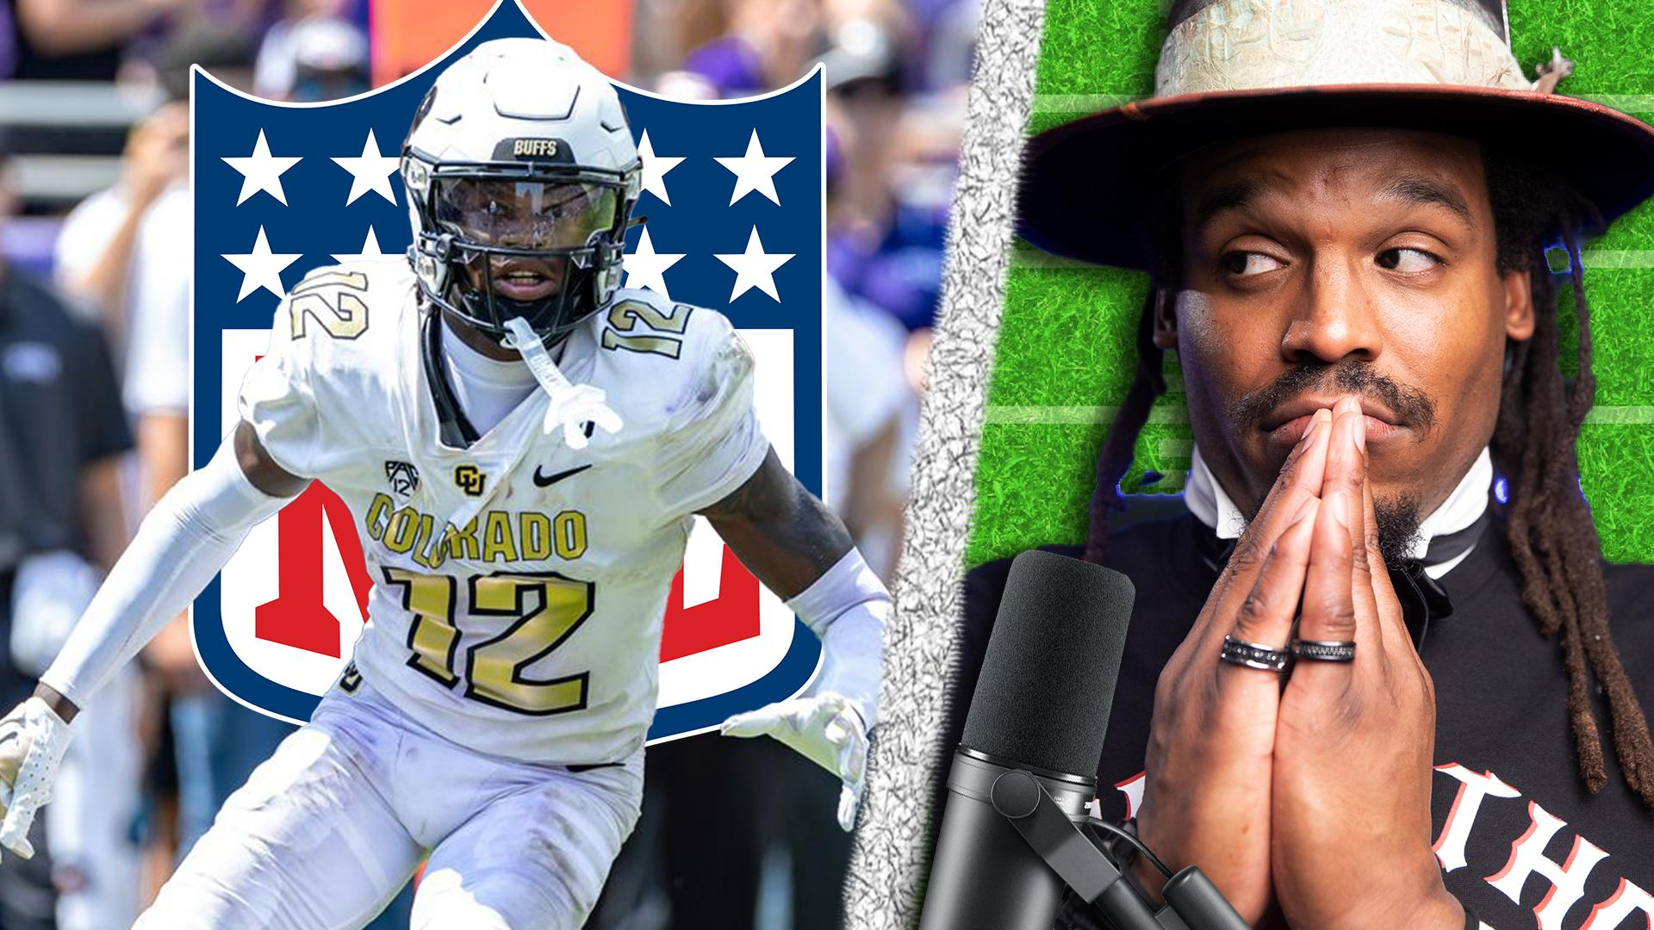
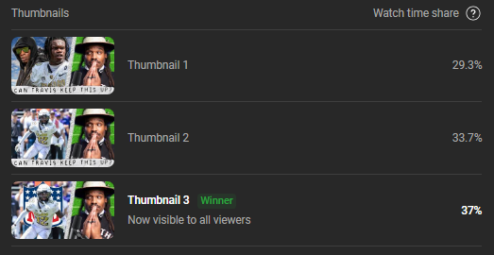
Iconic Saga
Vidsummit learnigns
2024
How to implement

Slide 18
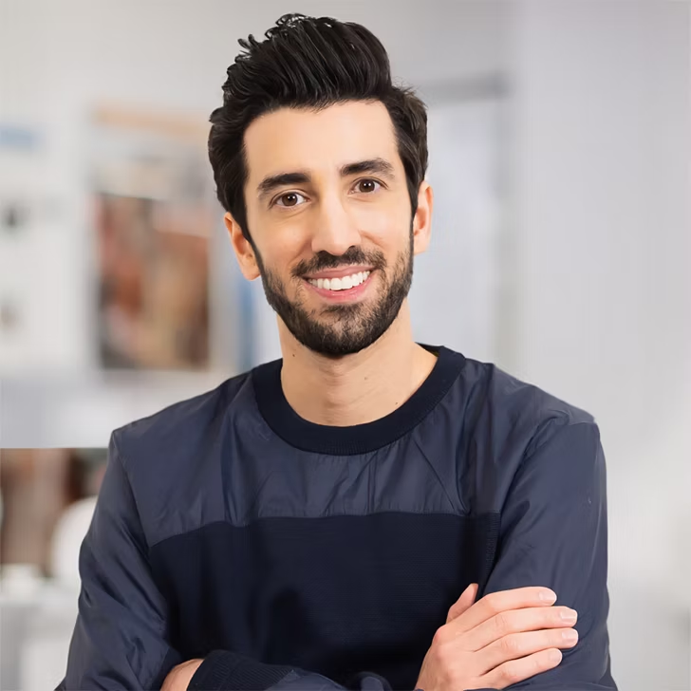
Iconic Saga
Vidsummit learnigns
2024
Jon Youshaei - talk 2
One of few marketers to work at both YouTube and Instagram, During five years at YouTube, Jon was Head of Creator Product Marketing where he worked with YouTube's top creators and brands to grow their audience and their incomes. During three years at Instagram, Jon helped build their creator team to empower even more creators to grow and monetize. Now a creator himself, Jon gained 500K+ followers and 300M+ views in the past year while interviewing Logan Paul, Danny Duncan, Mark Rober, Liza Koshy, Zach King, Peter McKinnon, and more and being recognized by LinkedIn as one of their Top Voices on the platform.

Slide 19
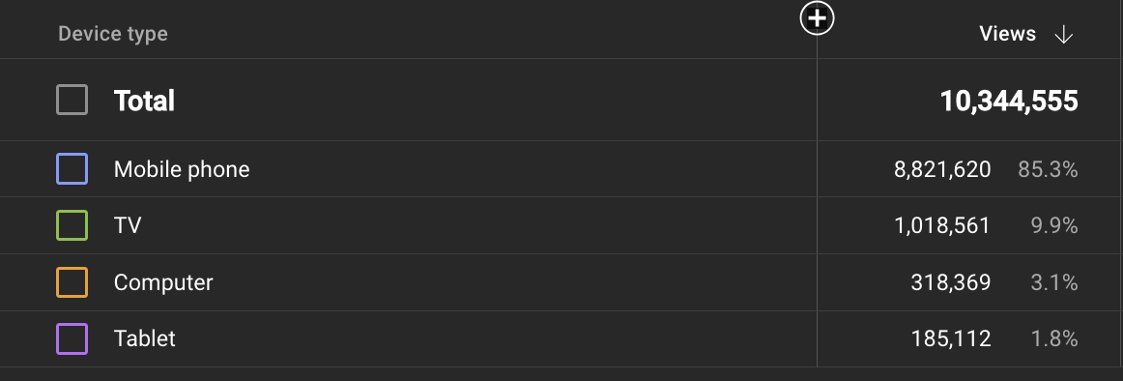
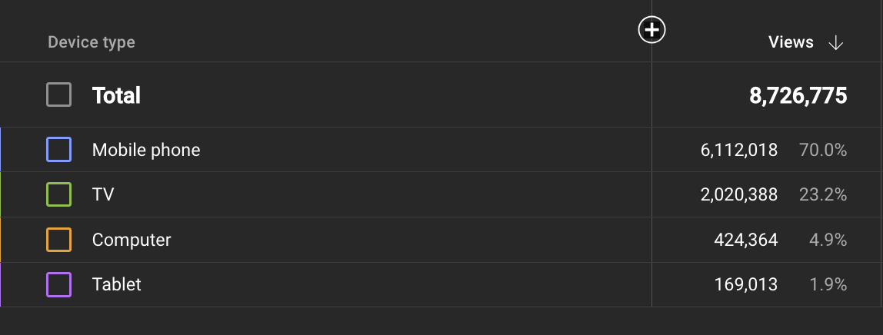
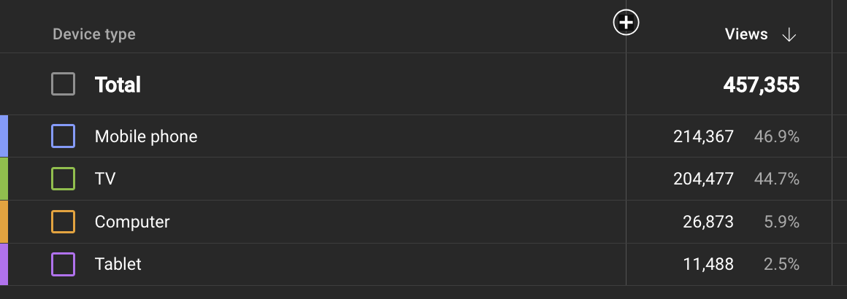
Iconic Saga
visummit learndngs
2024
YouTube on tv growth
August 2023
August 2024

Slide 20
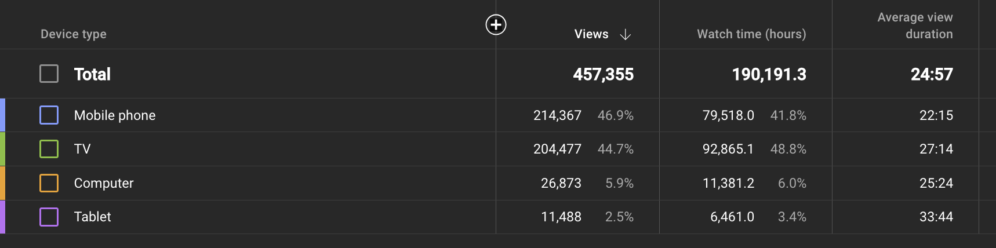
Iconic Saga
Vidsummit learnings
2024
Ads
Average view duration
Make links QR codes
we can put MORE in as AVD rises
We can put them further into video
tv AVD is 5 mins higher than mobile… people are watching LONGER on tv. Make content better for THEM
Length
make these videos longgggg. We make way more $ and the viewers are telling us they are enjoying the longer videos
Tv Viewers

Slide 21
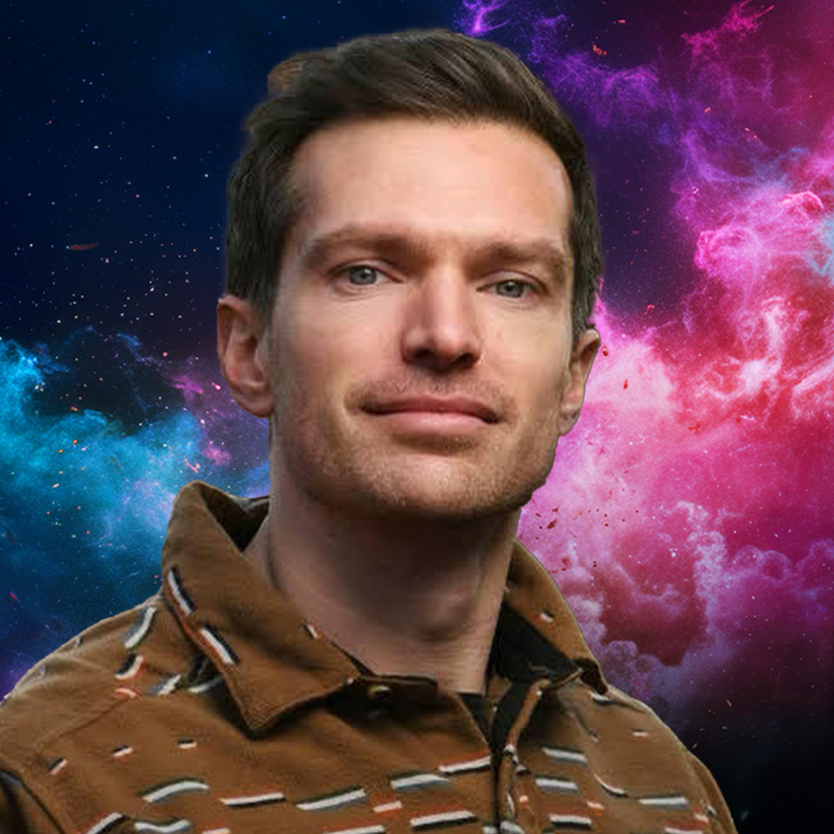
Iconic Saga
Vidsummit learnigns
2024
Jared Shores - talk3
Founder of Crux Media, Jared Shores boasts 15+ years of video expertise, spanning TV, film, and YouTube. Co-creator of Studio C, and working with clients including Chick-fil-A, Imagine Dragons, Kaskade, UNHCR, and HopeScope. With Emmy wins, a Gold Play button, and Oscar shortlisting, his work's 2.5+ billion views speak volumes. A master of storytelling and production, Jared is your new best friend.

Slide 22

Iconic Saga
Vidsummit learnigns
2024
August 2024
52,603,892 total monthly views
December 2024
80 million total monthly views
Goals
May 2025
Pen to paper
Let's grow our content, let's BE the company we all want to be
Total monthly views includes every single platform we post on
Average 70 million total monthly views
August 2025
100 million total monthly Views

Slide 23
Iconic Saga
visummit learndngs
2024
Funky Friday 100m goal
4th&1 100M goal
40-50 million views TOTAL
Hero Podcasts averaging 1-2 million views
Clips at 1-5 million views
Shorts at 30 million views
Old content at 10 millions views
30-40 million views TOTAL
Hero pod averaging 200k-400k
clips at 2-5 millions views
Shorts at 20 million views
Old content at 5 million views
Vertical platforms
Revenue
We need strong time investment into Funky Friday verticals
used to be MASSIVE now it’s far below 4th&1
We need to commit to learning how to convert viewers from vert to hero
Tiktok could be MASSIVE if we lean in (tiktok was 40.36% of our views last month)
Last month ALL VIEWS included our CPM was $1.78
dont be scared this is inclusive of non monetized platforms
100m views would equal $178,297.61

Slide 24

Iconic Saga
Vidsummit learnings
2024
“
Create a writers room. Acting alone doesn’t get you as far
— Jared

Slide 25
Iconic Saga
visumbit lsagaseg
2024
Bring ideas out of DMs
Look back
Bring content ideas together, build off others ideas
Dedicated time IS THE ONLY WAY TO IMPROVE
Start experiments
Analyze results
Assign deliverables
Our data tells us everything we need to know
Look at what worked and do more of that
Experiment with new ideas, don't be afraid to fail

Slide 26
Iconic Saga
Vidsummit learnings
2024
Competition
New Sources
The shows that post more regularly than us, what are they talking about? What preformed? Don’t pretend we need to reinvent the wheel
REDDIT is not only a great place to find topics but SORT topics. Sort by TOP ALL TIME, but also MOST CONTROVERSIAL to see what stirred up comments and conversation
Tent Poles
Dont just talk about tent poles, bring up past versions of the tent pole. Talk about big moments surrounding it.
BEST superbowl moments of past 50 years
Best catch in super bowl history
Research

Slide 27
Iconic Saga
Vidsummit learnings
2024
VidSummit takeaways
Kent Heckel

